Slide 1
GROWTH HORMONE

Slide 2
Target organs
Liver
Bone and cartilage
Muscle
All cells

Slide 3
Effects
Increased blood glucose
Increased growth of bone, cartilage and muscle
Stimulates mitosis

Slide 4
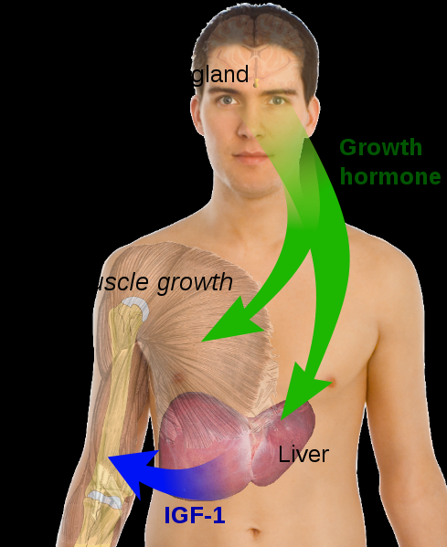

Slide 5
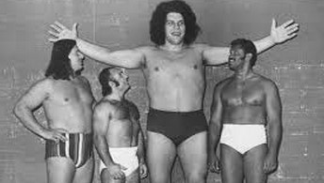
Acromegaly (excess GH)
Caused by pituitary malfunction – usually cancer
Large hands, feet, lips and general height

Slide 6

GH deficiency
Also caused by tumour of pituitary
Half growth rate in childhood
Delayed puberty
Reduced bone and muscle growth
Kewpie face

Slide 7
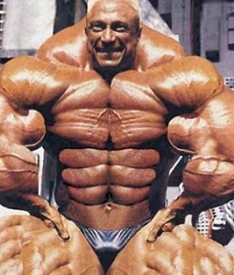
Excess GH
Taken by adults as muscle/strength promotor
GH is not a steroid

